Slide 1
My Medical Buddy

Slide 2
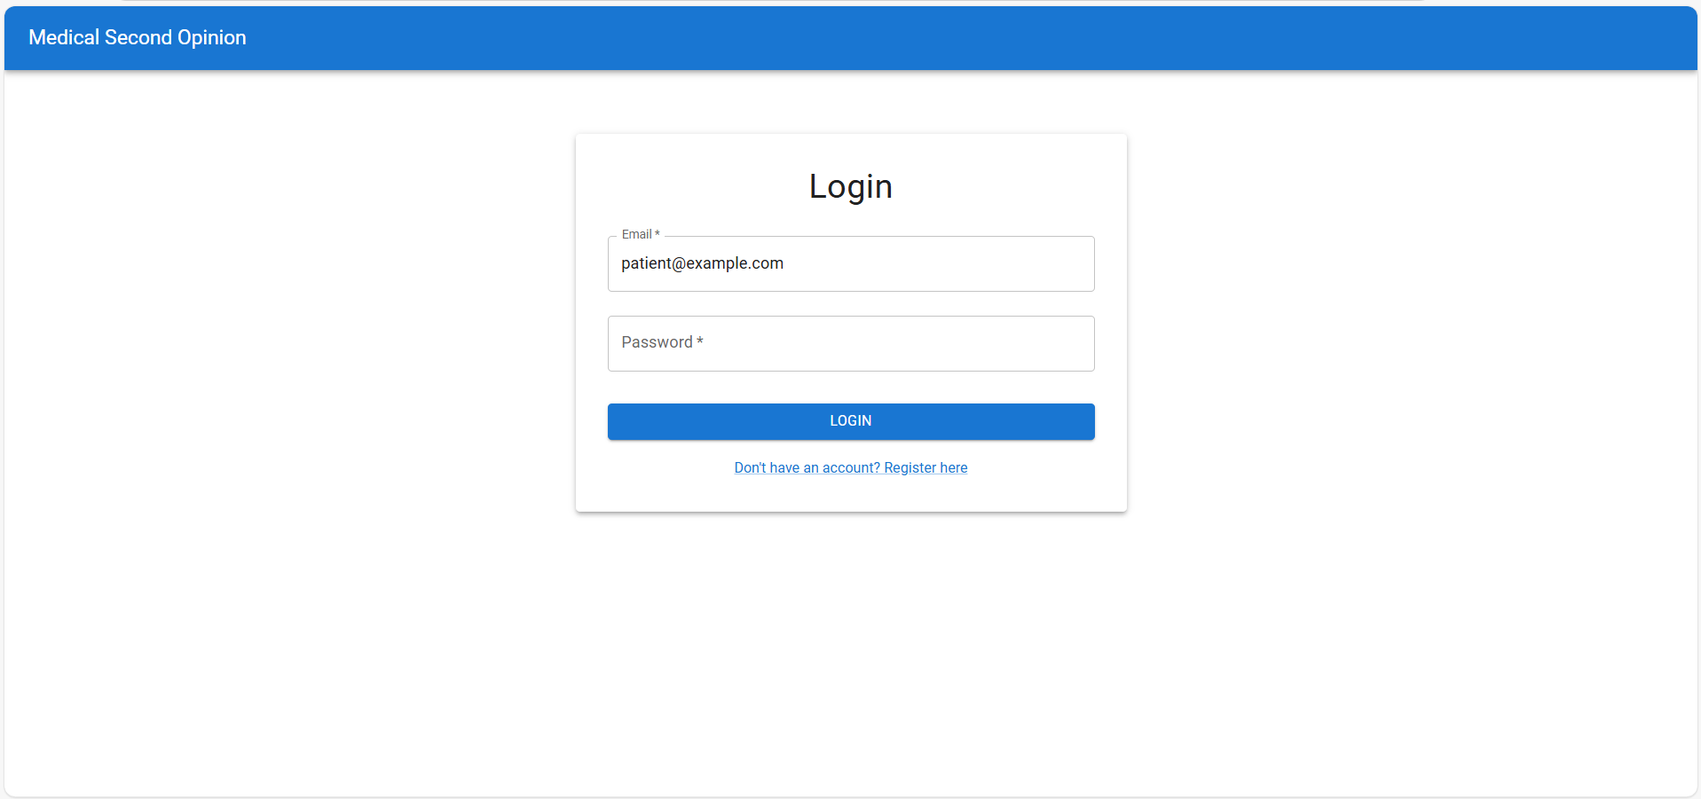
Login Screen

Slide 3
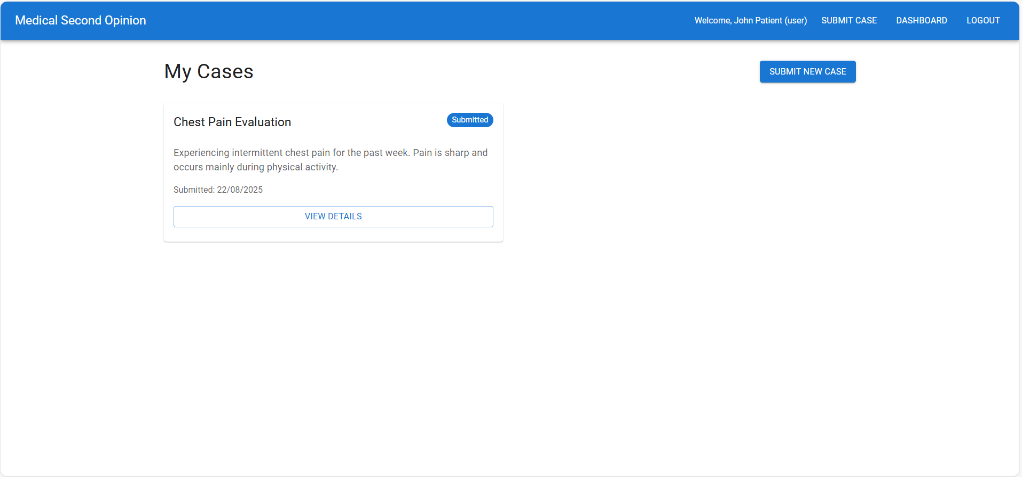
Patient Login & Dashboard

Slide 4
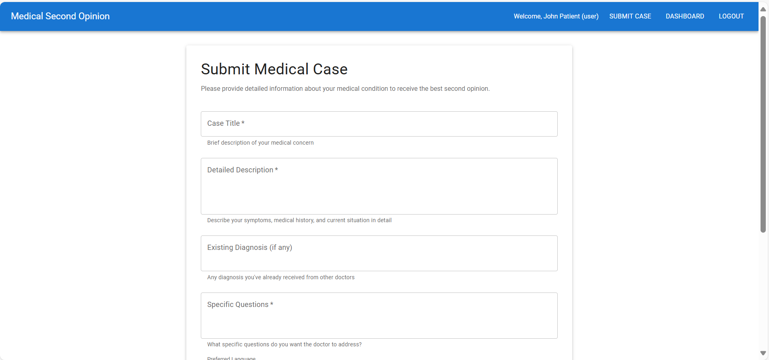
New Case Submission Form

Slide 5
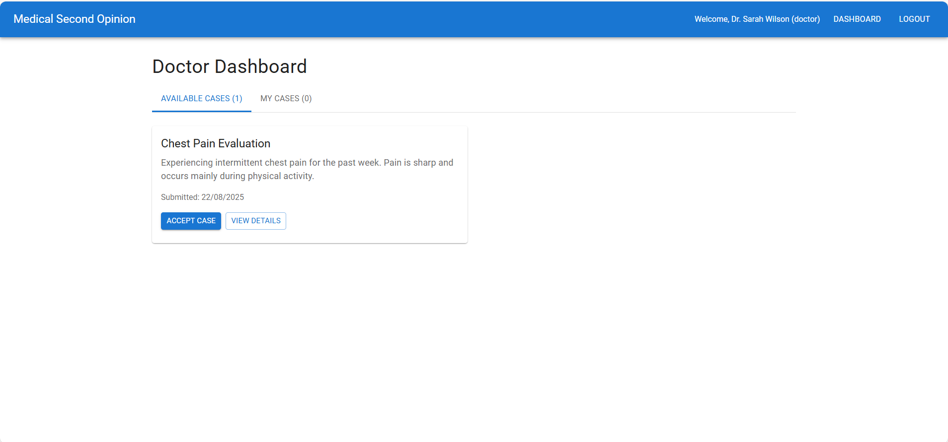
Doctor Login & Dashboard

Slide 6
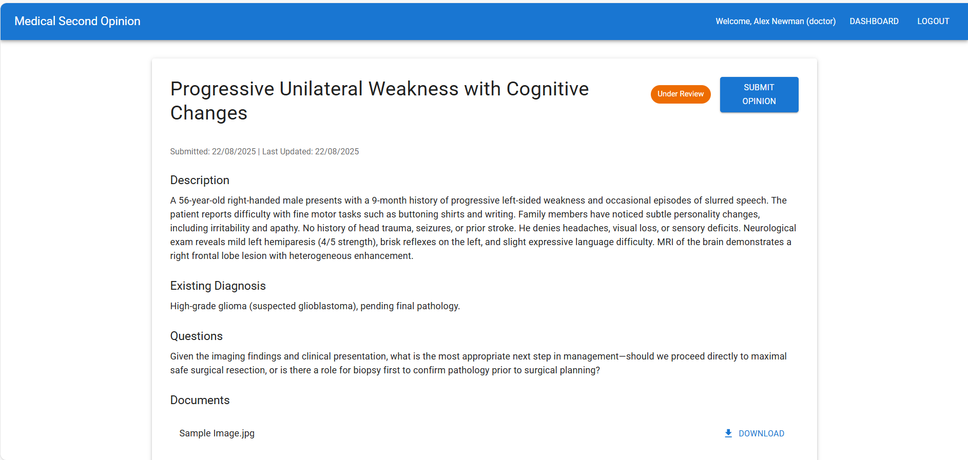
Doctor’s Screen to Review and provide opinion

